Slide 1
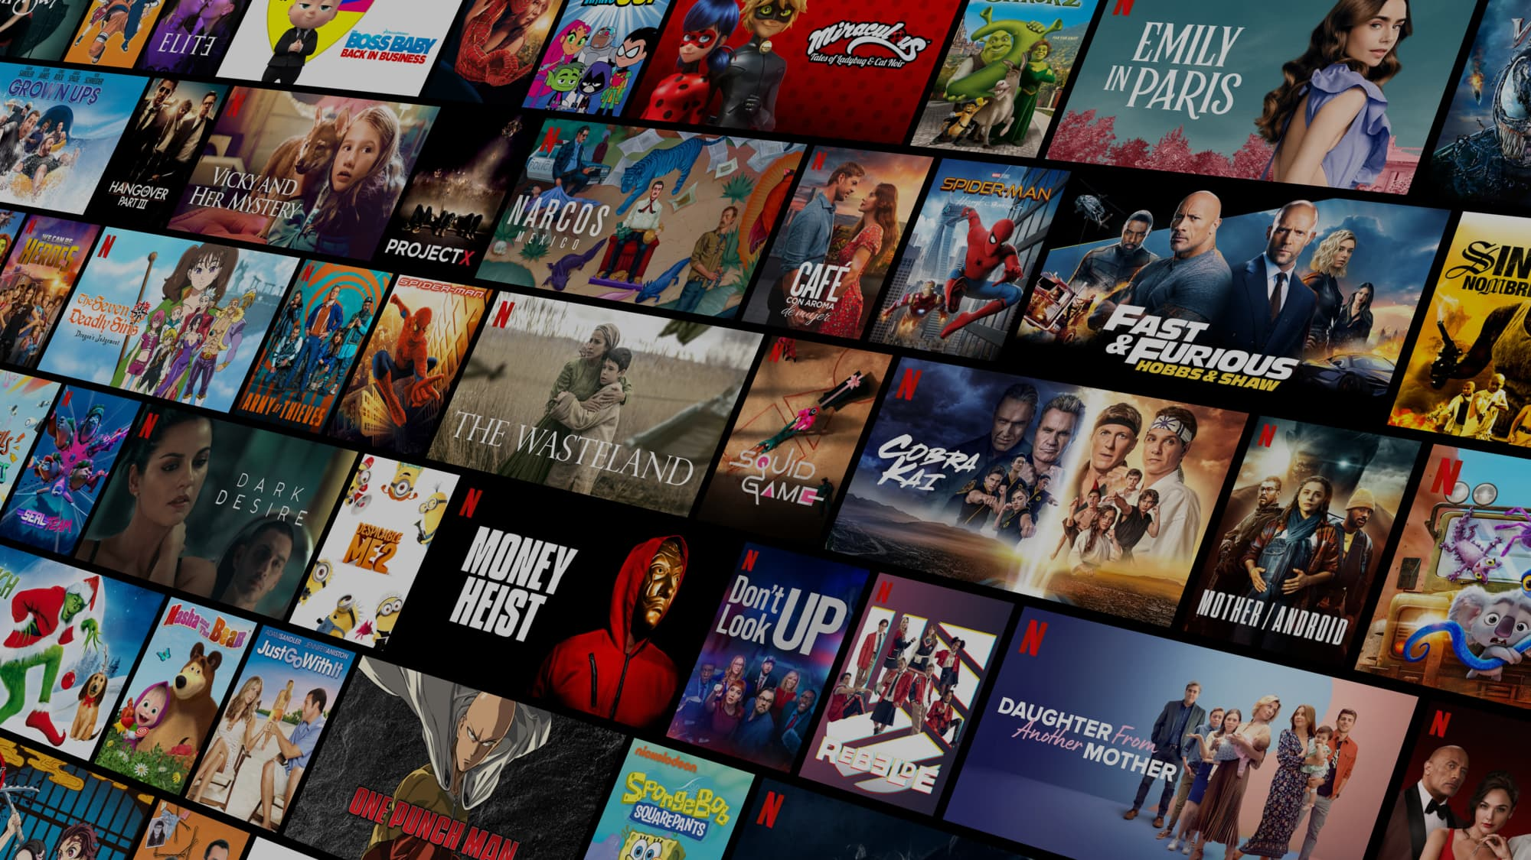

Final Project
Netflix TV Shows and Movies Analysis
Intro to Data Science - IST 687
Kelsey Kirby
Blessy Thomas
Hannah VanTilburg
Patrick Walsh
Mark Stiles
December 12, 2022

Slide 2
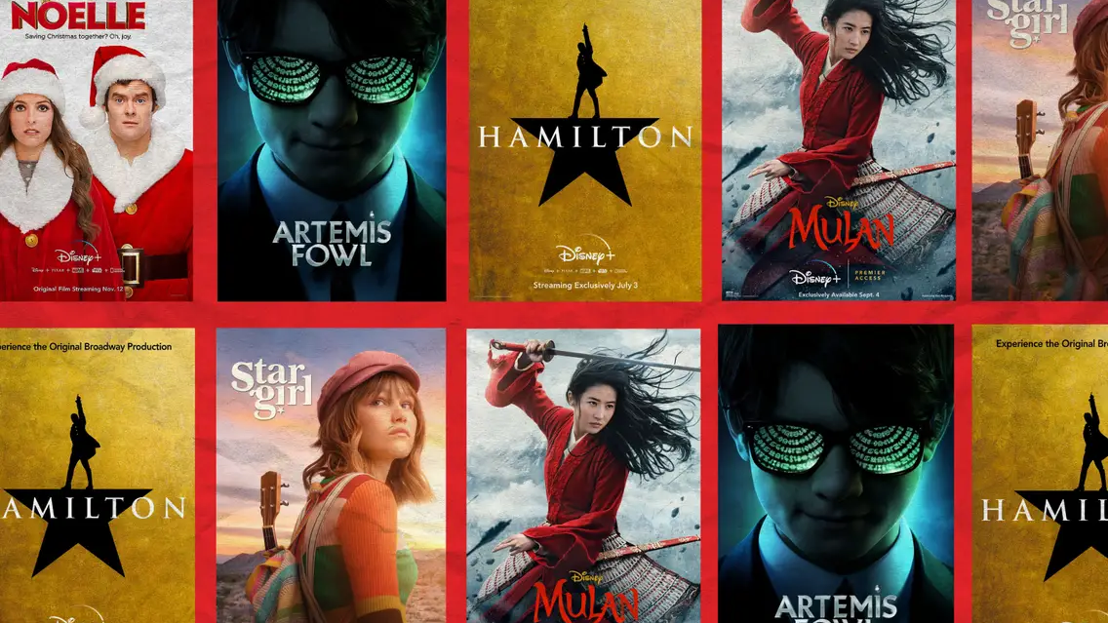
Agenda
Project Objective
Dataset
Exploratory Analysis
TV Show Analysis
Data Analysis
Predictive Modeling
Challenges

Slide 3
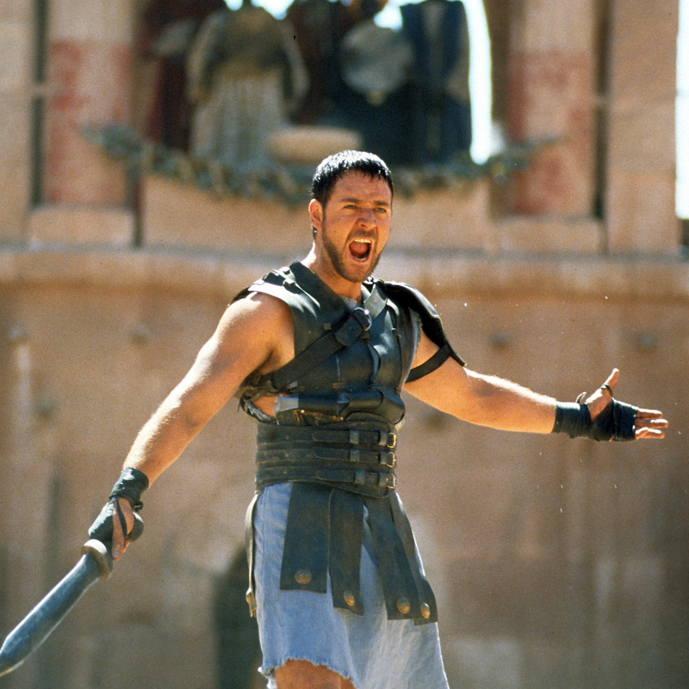
"A key factor in predicting whether moviegoers will be sitting on the edge of their power-reclining seats is reviews, both by professional movie critics and the general public.”
University of Technology, Sydney. (2017, November 7) https://phys.org/news/2017-11-explores-movie-successful.html
Motivation

Slide 4

We wanted to see if we could predict if a potential future movie would be critically successful
Determine what factors lead to high user satisfaction
Objective

Slide 5

IMDB users vote on content
Rating is average vote score
Users can update their votes
IMDB Score

Slide 6
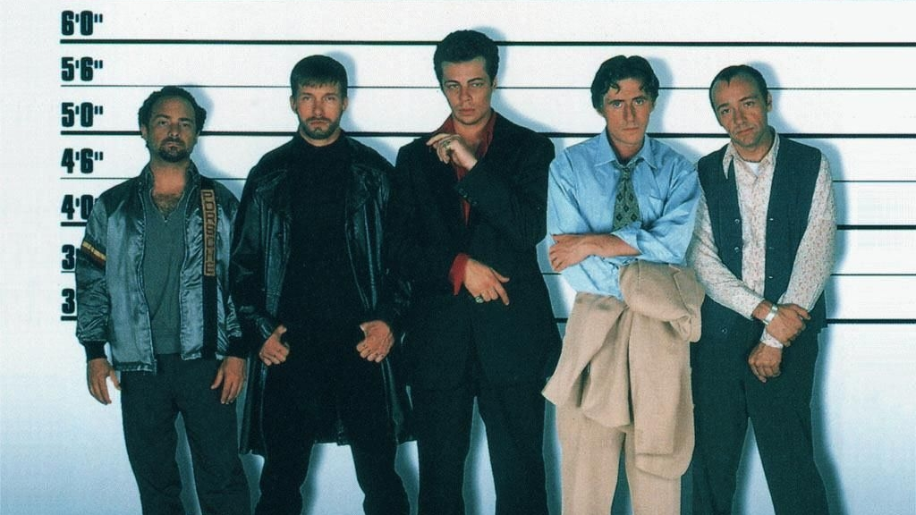
Dataset

Slide 7
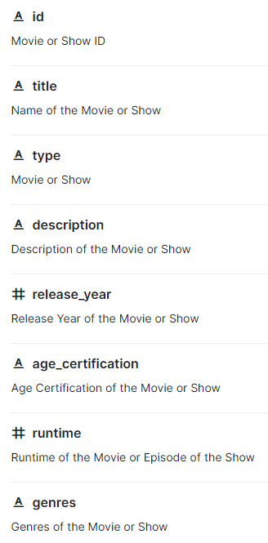
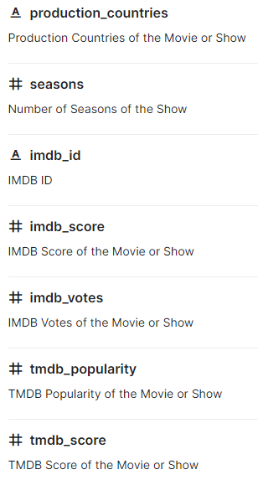
kaggle.com/datasets/victorsoeiro/netflix-tv-shows-and-movies
1000 Observations x 16 variables
Focus on:
Numeric
Release Year
IMDB Score
IMDB Votes
Runtime
Seasons
Categorical
Age Certification
Genre
Production Countries

Slide 8
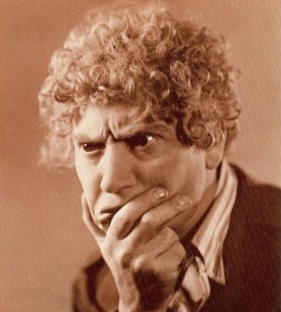
There would be a reasonable correlation between Runtime, Season, Year and Genre to predict an IMDB Score
Assumptions

Slide 9
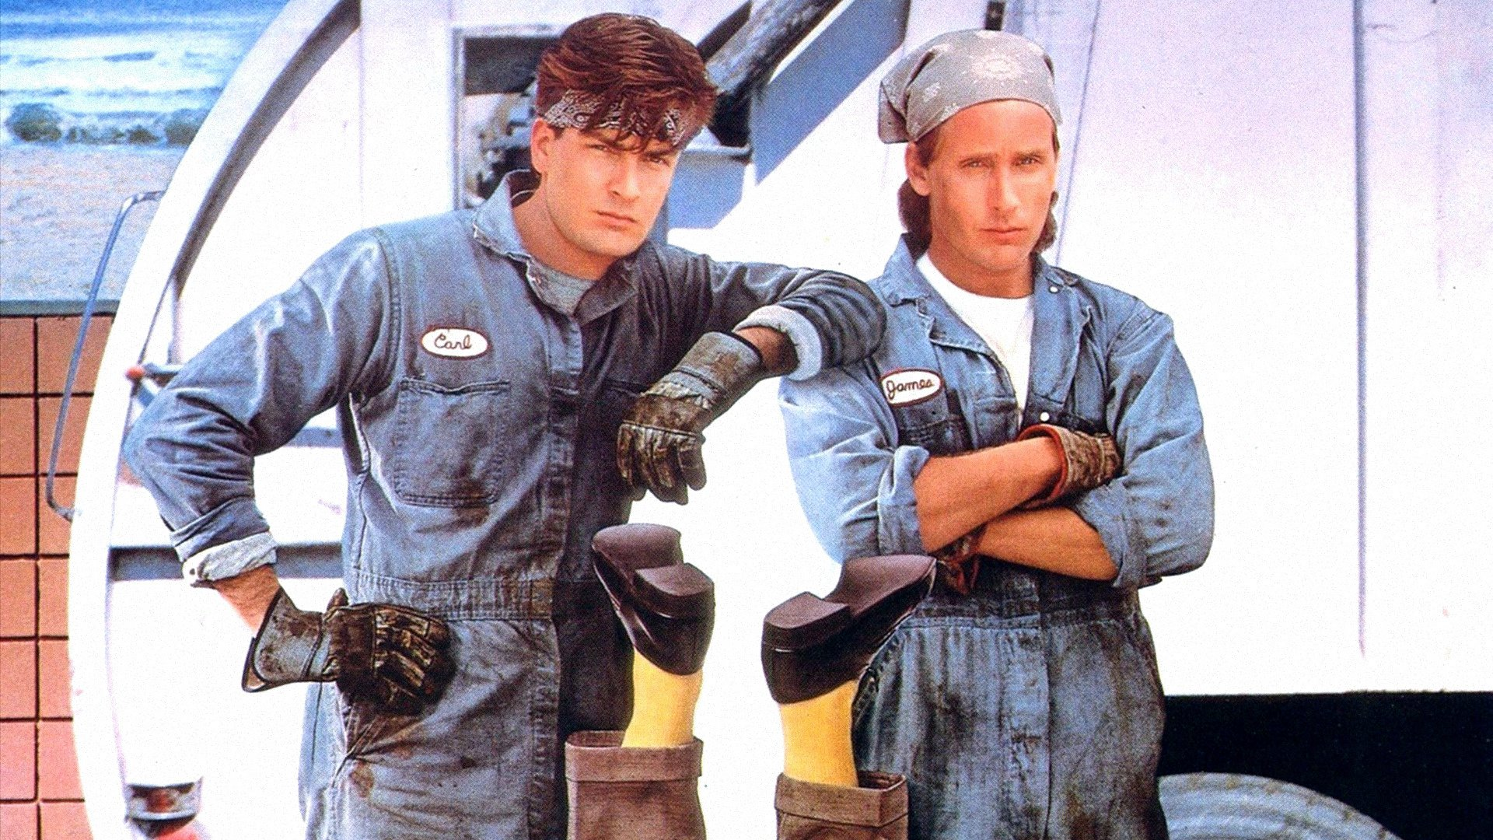
Munging

Slide 10

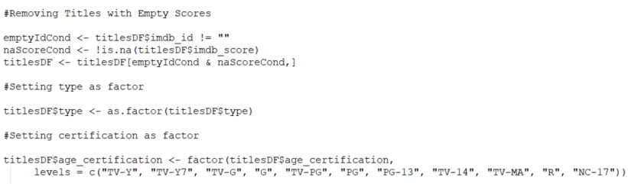
Initial Cleanup

Slide 11
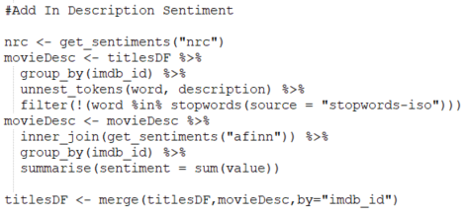
Custom Sentiment Measurement

Slide 12
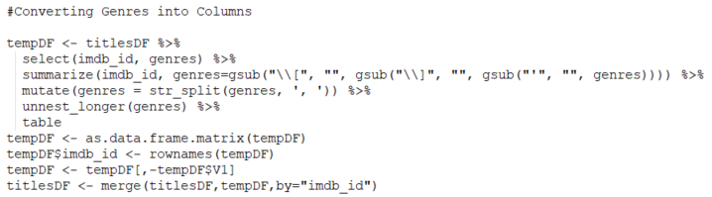
Restructure Genres

Slide 13
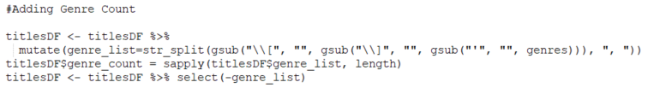
Custom Genre Count

Slide 14

Exploratory Analysis

Slide 15
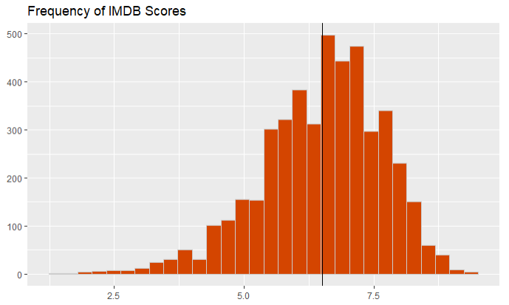
Most movies received IMDB Scores of around 7/10

Slide 16
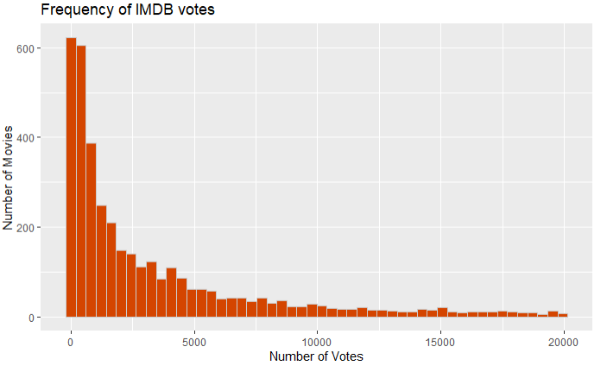
Most movies received fewer than 2,500 votes

Slide 17
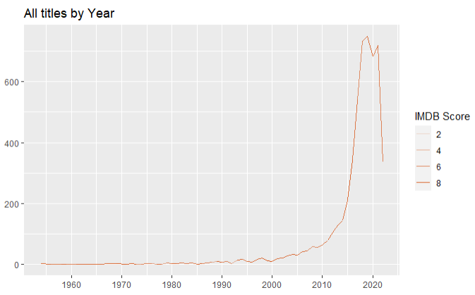
There was a dramatic increase in film production starting around 2010

Slide 18
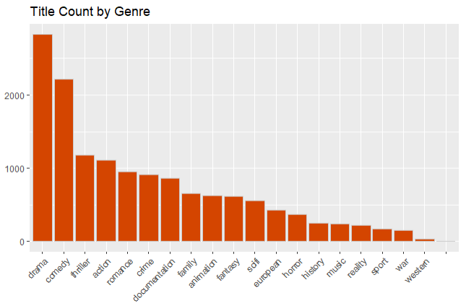
The most common genre was drama, followed by comedies

Slide 19
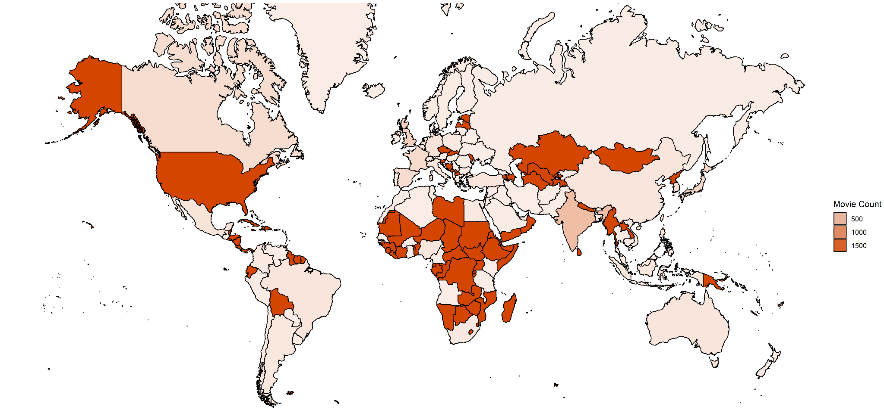
Movies were produced primarily in the U.S., Africa, and central Asia
Production Country of Titles

Slide 20
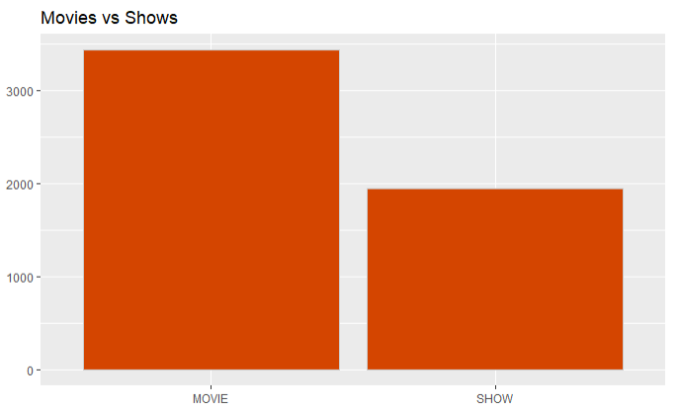

Slide 21

TV Show Analysis

Slide 22
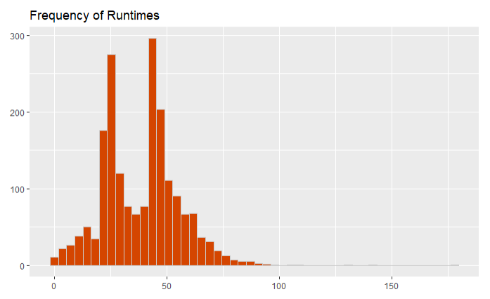
Most TV shows fall into a runtime of around 30 minutes or 1 hour

Slide 23
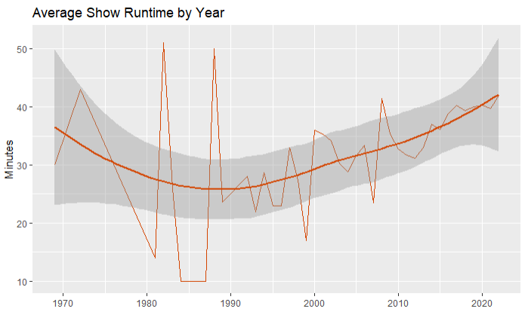
TV show runtime dipped in the 1990s and have been on a steady incline ever since

Slide 24
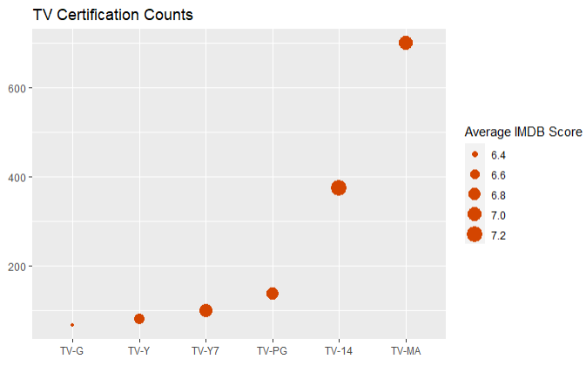
The highest rated TV shows fall within the TV-14 and TV-MA certifications

Slide 25

*Generated from TV show descriptions*

Slide 26

Data Analysis

Slide 27
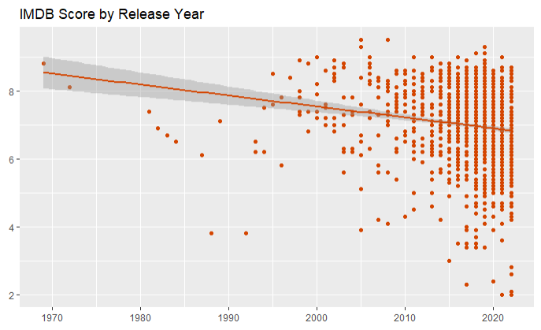
While there has been a general decline in IMDB scores since the 1970s…

Slide 28
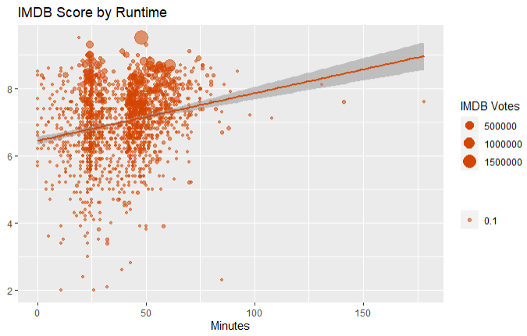
…IMDB scores generally increase as runtime increases.

Slide 29
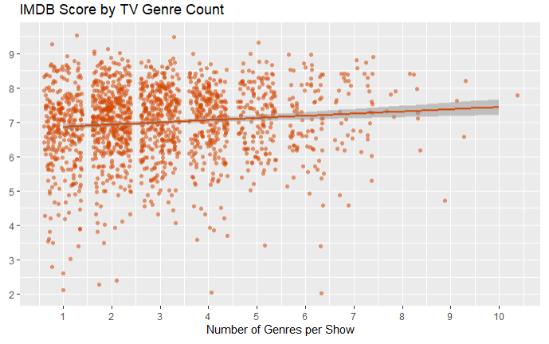
IMDB score increases slightly as the number of genres increases

Slide 30
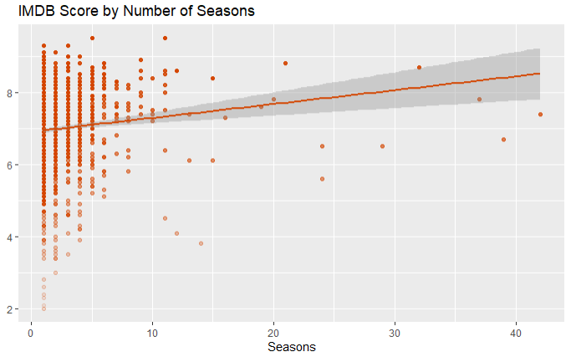
TV shows with more seasons tend to have higher IMDB scores

Slide 31
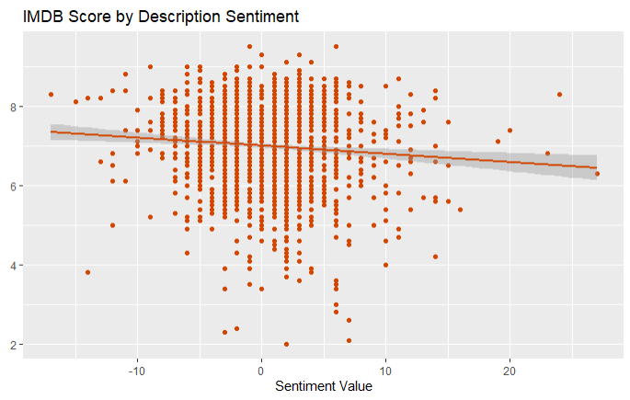
IMDB score decreases as description sentiment becomes more positive

Slide 32
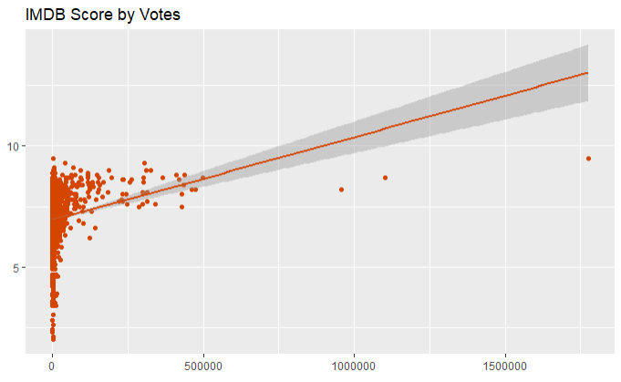
IMDB scores tend to increase as number of votes also increases

Slide 33
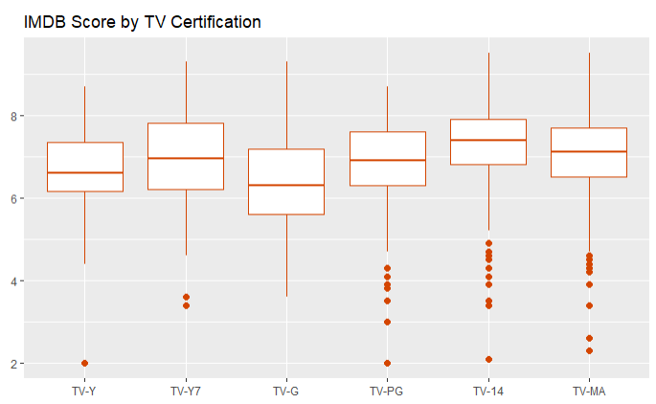
The distribution and median of IMDB scores varies somewhat between different certification ratings

Slide 34
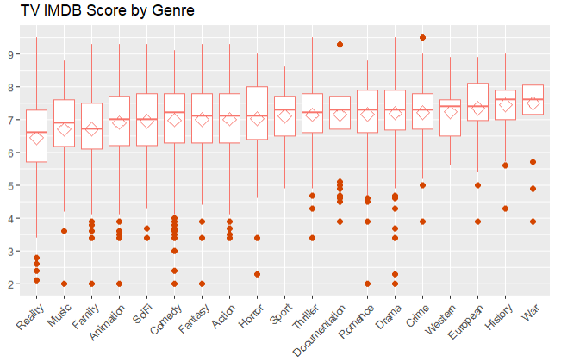
IMDB score distribution and median also varies only slightly from one genre to the next

Slide 35

Predictive Modeling

Slide 36
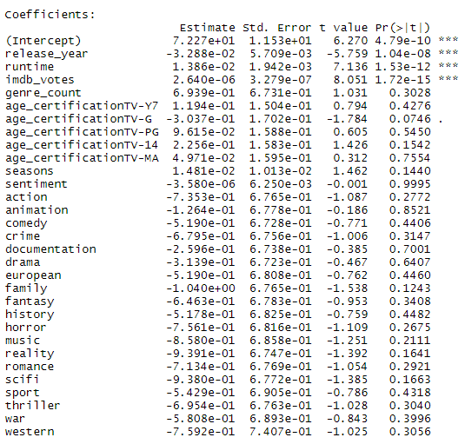
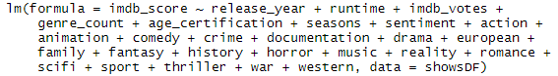
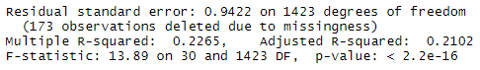
Linear Model
Significance
Formula
Results

Slide 37
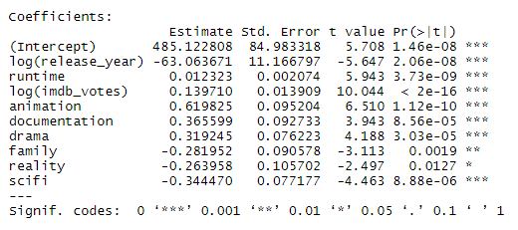
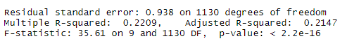
Linear Model
Significance
Formula
Results

Slide 38
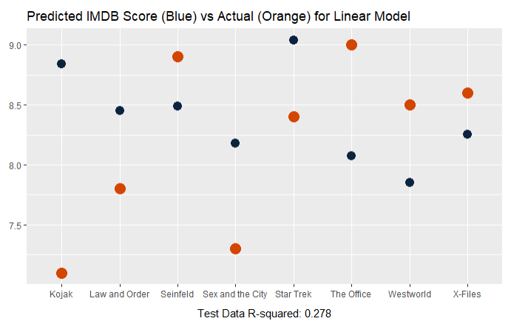
Linear Model

Slide 39
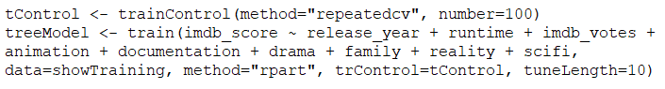
Regression Tree Model
Formula

Slide 40
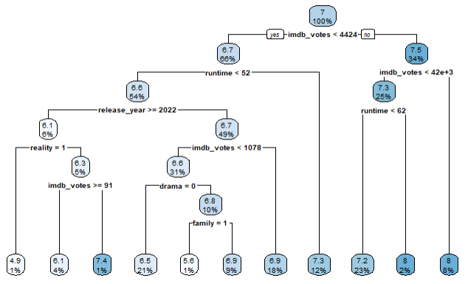
Regression Tree Model
Results

Slide 41
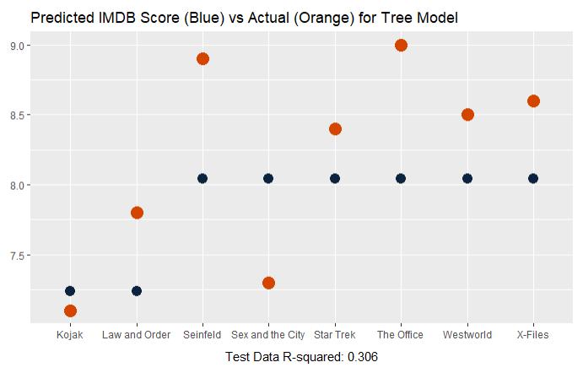
Regression Tree Model

Slide 42
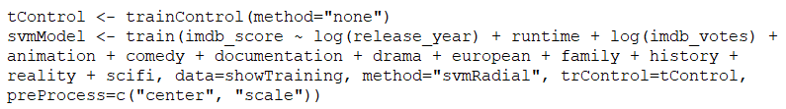
Scalable Vector Machine Model
Formula

Slide 43
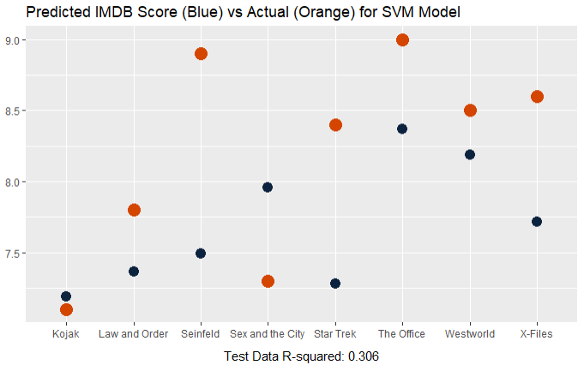
Scalable Vector Machine Model

Slide 44
Neural Network Model
Formula

Slide 45
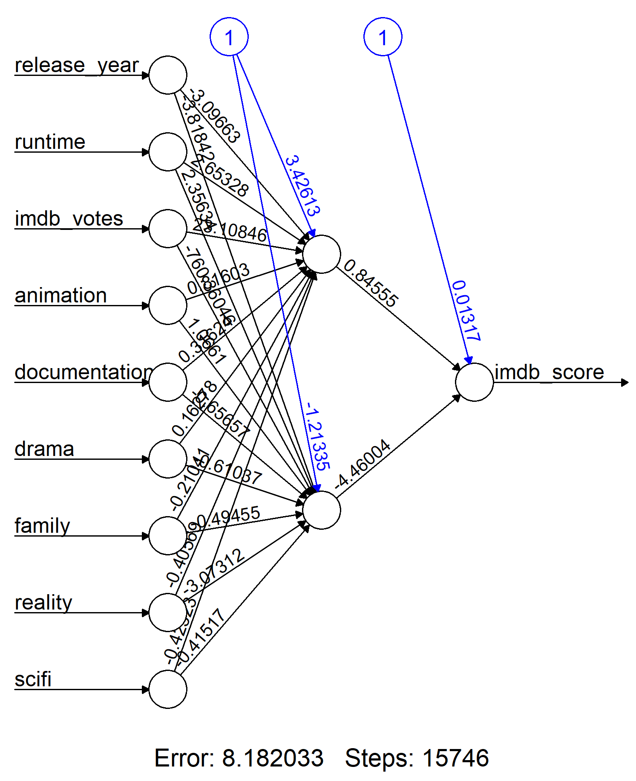
Neural Network Model
Results

Slide 46
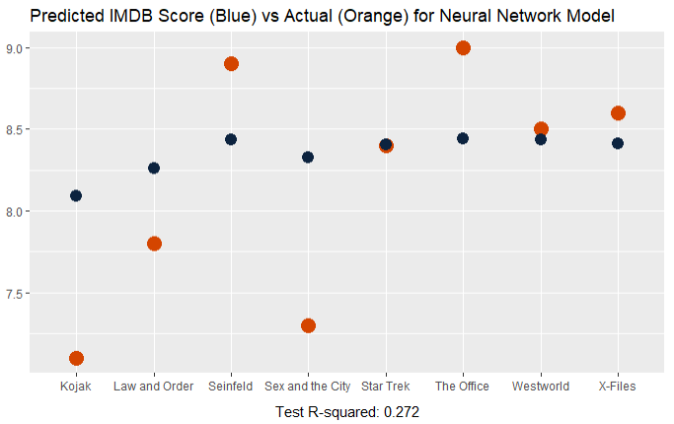
Neural Network Model

Slide 47
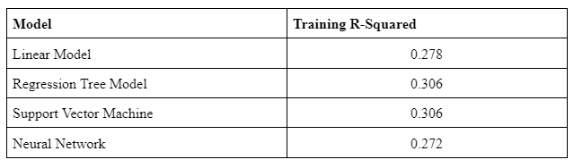
Overall Model Winner

Slide 48

Raters expectations change over time
Technology changes storytelling
Professional skills improve over time
New genres have come over decades
Not enough leading variables like Year or Runtime
Better data about content
Challenges

Slide 49

Number of views
% of people who finished all episodes
Average completion rate
Amount and type of referral (we think you’ll like, homepage banner)
Production budget
Director IMDB Score
Actor IMDB Scores
We Wish

Slide 50
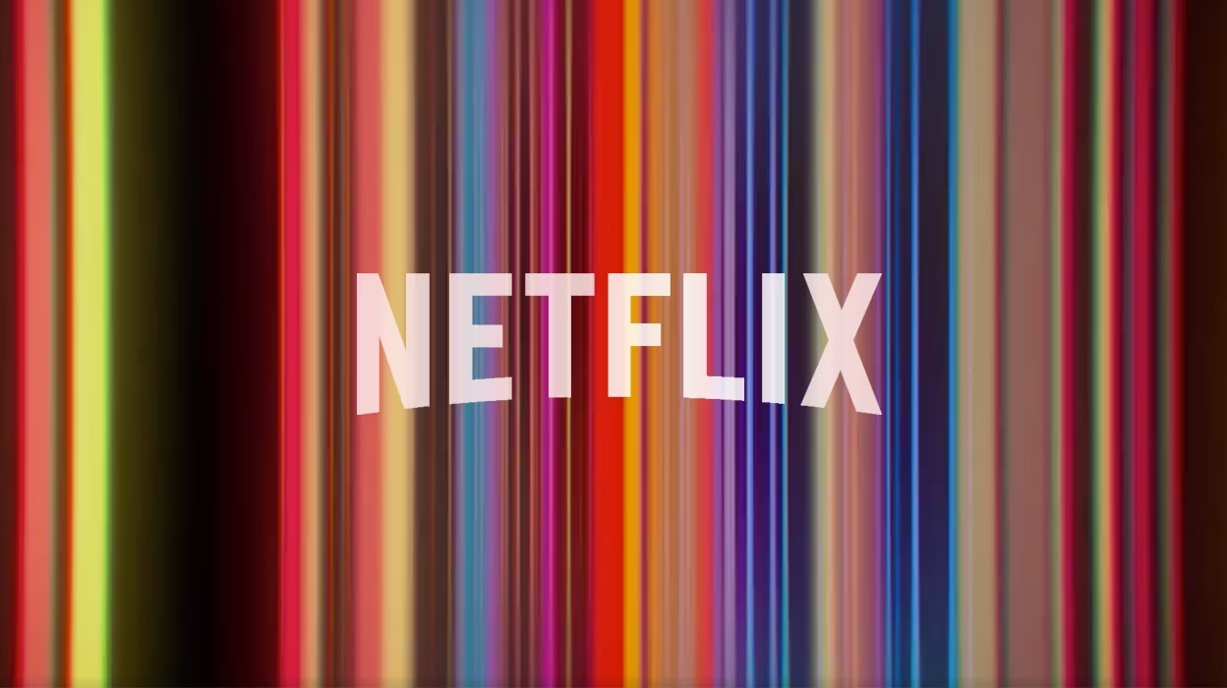
We want to entertain the world…
But predicting what you’ll like is really hard

